Slide 1
CHM 5681
Fluorescence Spectroscopy
Source
Detector
hν
Sample

Slide 2
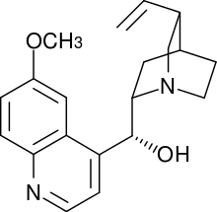
Fluorescence Spectroscopy
First observed from quinine by Sir J. F. W. Herschel in 1845
Filter
Church Window
400nm SP filter
Yellow glass of wine
400 nm LP filter
hν
Quinine Solution
(tonic water)
Observe
Blue emission
Herschel concluded that “a species in the solution exert its peculiar power on the incident light and disperses the blue light.”

Slide 3
Fluorescence Spectroscopy
Measuring the light given off by an electronically excited state.
Ground State
(S₀)
Singlet Excited State (S₁)
hν
hν
Fluorescence
Excitation
Emission
Intersystem Crossing
hν
Phosphorescence
Emission
Triplet Excited State (T₁)

Slide 4
Fluorescence Spectroscopy
Singlet Excited State (S₁)
Fluorescence
Spin allowed
Fast (ns)
Organic molecules
hν
Emission
Triplet Excited State (T₁)
Phosphorescence
Spin “forbidden”
slow (μs to s)
Transition metal complexes
hν
Emission

Slide 5
Jablonski Diagram
S₂
Excitation
Internal Conversion
Fluorescence
Non-radiative decay
Intersystem Crossing
Phosphorescence
S₁
T₂
Energy
T₁
S₀

Slide 6
Fluorescence
S₂
1) Excitation
  -Very fast (< 10⁻¹⁵ s)
  -No structure change
2) Internal Conversion
-Fast (10⁻¹² s)
-Structure change
3) Fluorescence
-”Slow” (10⁻⁹ s)
- No structure change
2
1
S₁
Energy
3
S₀
Geometry

Slide 7

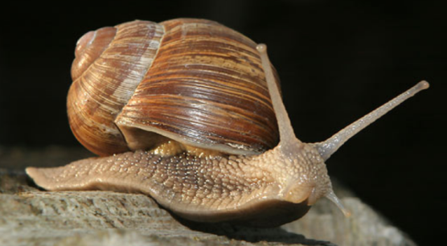
Fluorescence
Sprinter (7 m/s)
Snail (0.005 m/s)
S₂
ν₃
ν₂
ν₁
IC
S₁
ν₃
ν₂
ν₁
Internal Conversion (sprinter) “always” wins!
Absorption
Fluorescence
Kasha’s Rule:
Emission predominantly occurs from the lowest excited state (S₁ OR T₁)
S₀
  Internal Conversion (10¹² s⁻¹)
  S₂ Fluorescence (10⁹ s⁻¹)

Slide 8
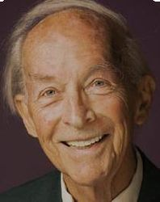
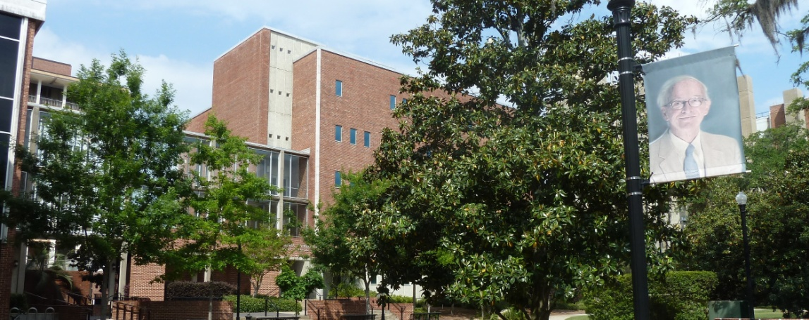
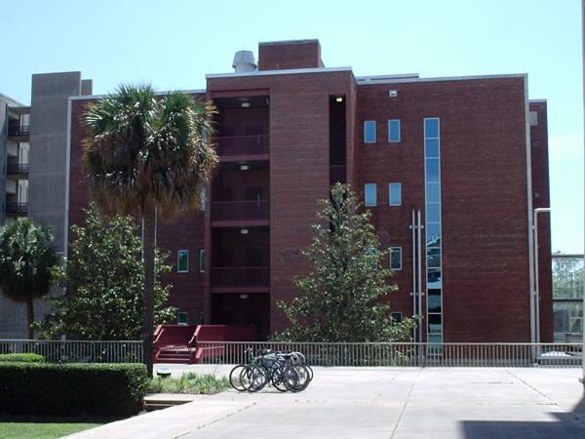
Fluorescence
Kasha Laboratory Building
AKA Institute of Molecular Biophysics
1920-2013
Kasha’s Rule:
Emission predominantly occurs from the lowest excited state (S₀ OR T₁)

Slide 9
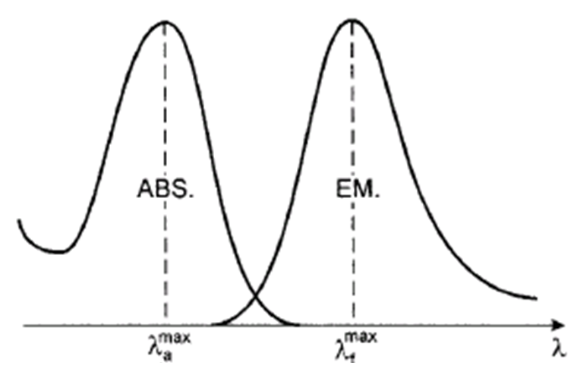
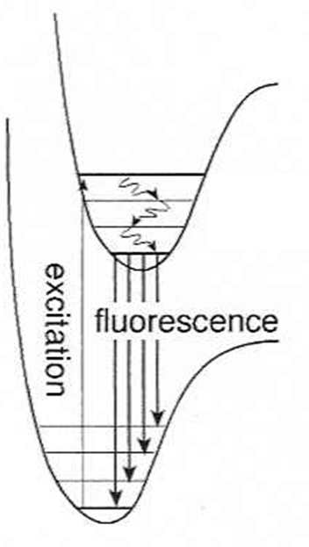

Fluorescence
Kasha’s Rule:
Emission predominantly occurs from the lowest excited state (S₀ OR T₁)
Blue
Higher E
Red
Lower E
S₁
S₀
Internal
Conversion
E_{absorption} > E_{emission}
Emission is red-shifted (bathochromic) relative to absorption
Absorption is blue-shifted (hypsochromic) relative to emission

Slide 10
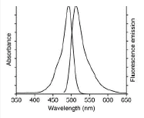
Mirror Image Rule
  Vibrational levels in the excited states and ground states are similar
  An absorption spectrum reflects the vibrational levels of the electronically excited state
  An emission spectrum reflects the vibrational levels of the electronic ground state
  Fluorescence emission spectrum is mirror image of absorption spectrum
v’=5
v’=4
v’=3
v’=2
v’=1
v’=0
S₁
v=5
v=4
v=3
v=2
v=1
v=0
S₀

Slide 11
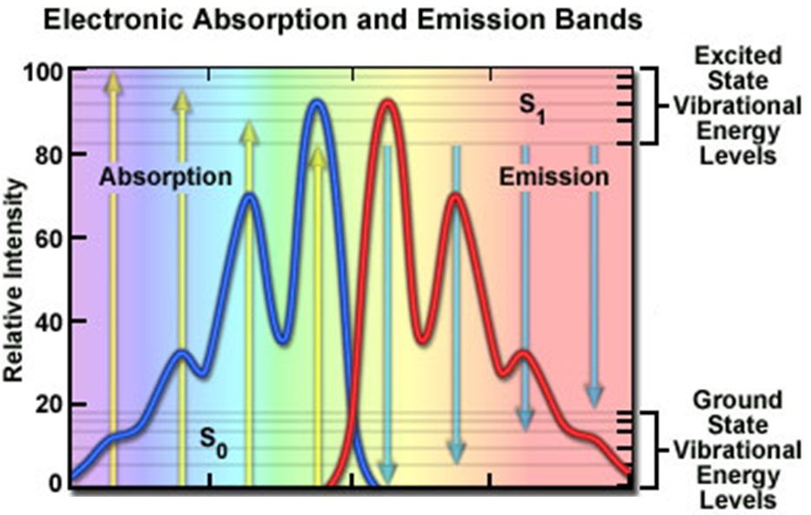
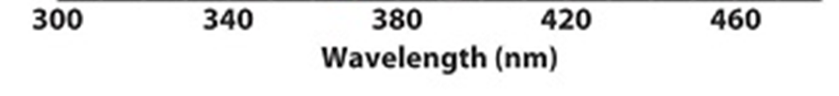
Mirror Image Rule
ν₄
S₁
ν₃
ν₂
ν₁
ν₄
ν₃
S₀
ν₂
ν₁

Slide 12
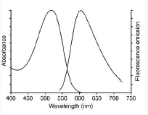
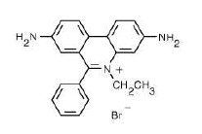
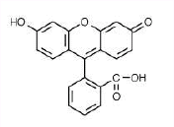
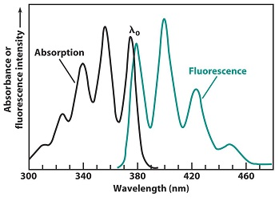
Mirror Image Rule
fluorescein
ethidium bromide
Anthracene

Slide 13
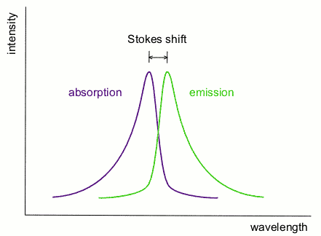
Stokes Shift
Stokes Shift:
Difference in energy/wavelength between absorption max and emission max.
S₁
S₀
Internal
Conversion
Sensitivity to local environment:
Solvent polarity
Temperature
Hydrogen bonding

Slide 14
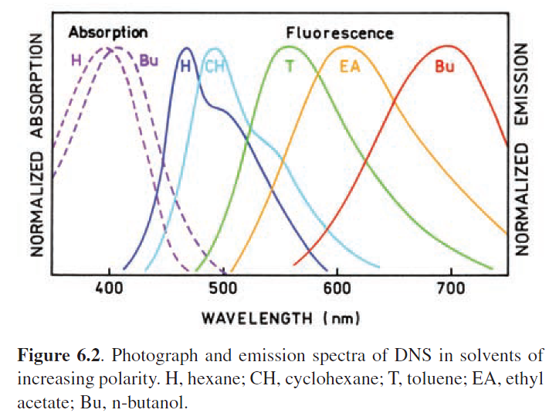
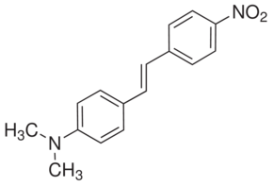
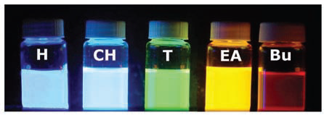
Solvent Dependence
Stokes Shift:
Difference in energy/wavelength between absorption max and emission max.
4-dimethylamino-4'-nitrostilbene (DNS)
Solvatochromism

Slide 15
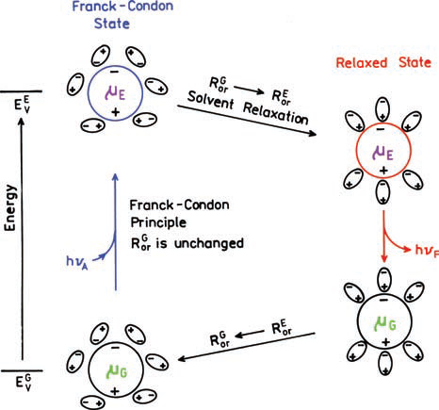
Solvatochromism

Slide 16
Jablonski Diagram
S₂
Excitation
Internal Conversion
Fluorescence
Non-radiative decay
Intersystem Crossing
Phosphorescence
S₁
T₂
Energy
T₁
S₀
hν
Intersystem Crossing
Emission
Singlet Excited State (S₁)
Triplet Excited State (T₁)
Ground State (S₀)

Slide 17
Phosphorescence
S₂
1) Excitation
  -Very fast (10⁻¹⁵ s)
  -No structure change
2) Internal Conversion
-Fast (10⁻¹² s)
-Structure change
3) Intersystem Crossing
-Fast (10⁻¹² s)
-No Structure change
4) Phosphorescence
-”Slow” (10⁻⁶ s)
- No structure change
T₂
2
3
S₁
1
2
E
T₁
4
2
S₀
Geometry

Slide 18
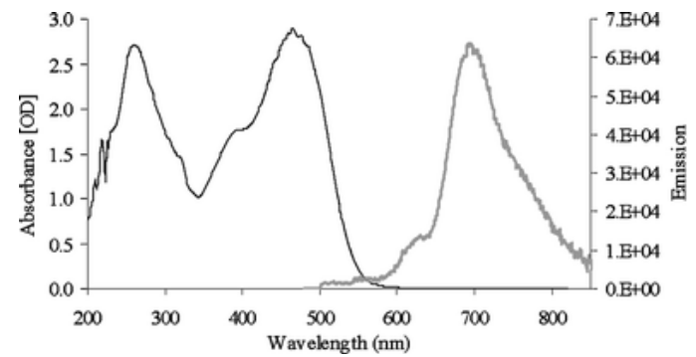
Emission
Fluorescence
Phosphorescence
Rates:
Lifetime:
Δλ:
O₂ sensitive:
Fast (10⁻⁹s⁻¹)
nanoseconds
<100 nm
no
Slow (10⁻⁶ – 0.1 s⁻¹)
>microseonds
>100 nm
Yes

Slide 19
Fluorescence vs Phosphorescence
Internal Conversion
(10⁻¹² s)
S₂
Intersystem Crossing
w/ Heavy atom (< 10⁻¹² s)
w/o Heavy atom (> 10⁻⁹ s)
S₁
E
T₁
Excitation
(10⁻¹⁵ s)
Fluorescence
(10⁻⁹ s)
Phosphorescence
(10⁻⁶ s)
S₀

Slide 20
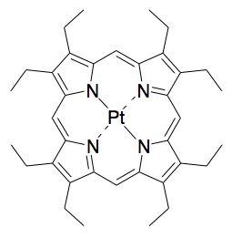
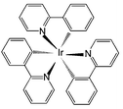
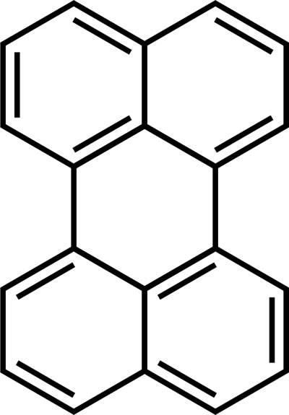
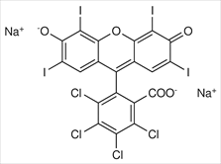
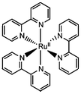
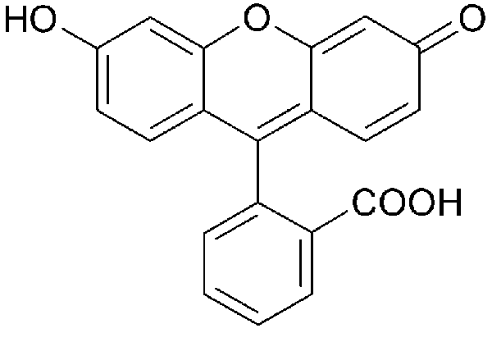
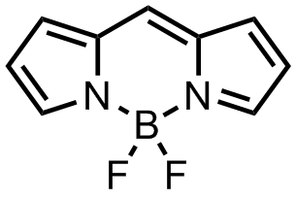
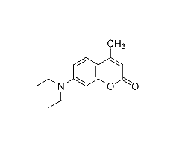
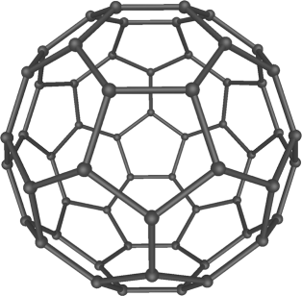
Emissive Molecules
Fluorescent
Phosphorescent
Perylene
OEP
PtOEP
Ir(ppy)₃
BODIPY
Fluorescein
Rose Bengal
[Ru(bpy)₃]²⁺
Coumarin
Anthracene
Anthracene + ICH₃
C60

Slide 21
Fluorometer
Source
Excitation
hν
Detector
Sample
hν
Emission
Variables
Excitation Wavelength
Excitation Intensity
Emission Wavelength
Filters

Slide 22
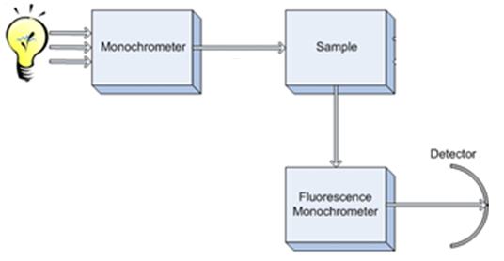

Fluorometer
3
1
2
Components
1) Light source
2) Monochrometer
3) Sample
4) Detector
5) Filters
6) Slits
7) Polarizers
2
4

Slide 23
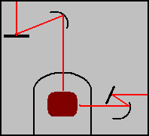
Fluorometer: Simple Diagram
Xenon Lamp
Grating
Mirrors
Excitation
Monochromator
Emission
Monochromator
PMT
Two light sources =
Two monochromators!
1 for excitation
1 for emission
Sample
Grating

Slide 24
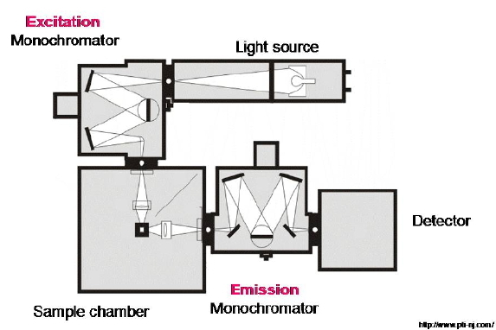
Fluorometer: Medium Diagram
Grating
Mirror
Mirror
Lens
Sample

Slide 25
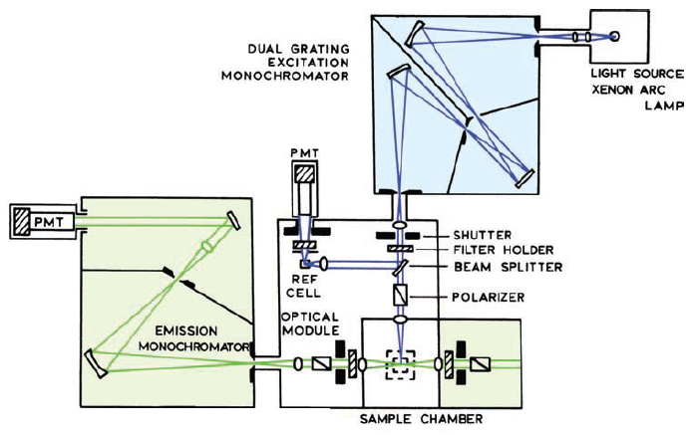
Fluorometer: Hard Mode
Grating
Mirrors
Mirror
Grating

Slide 26
Fluorometer: Hard Mode 2
450 W Xe
300 nm blaze
1200 g/mm
exit slit
iris
NIR:
9170-75=950-1700 nm
1000 nm blaze
600 g/mm grating
shutter
polarizer
slit
r
V
UV-VIS:
R928 = 250-850nm
500 nm blaze
1200 g/mm grating
V
V

Slide 27
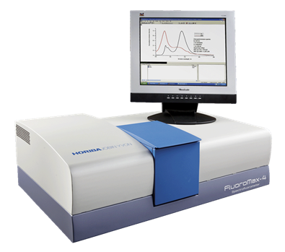
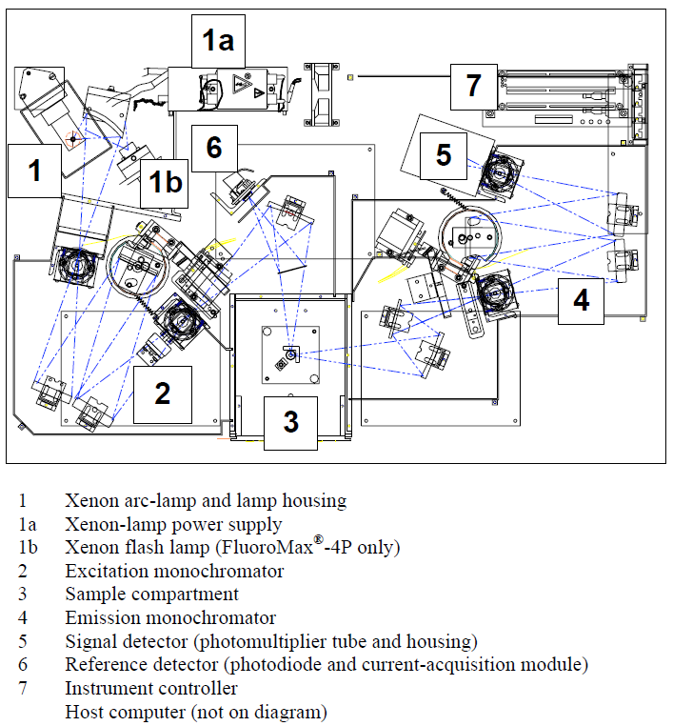
Horiba JY Fluoromax-4
Horiba JY Fluoromax-4
MAC Lab
(Materials Characterization)
CSL 116

Slide 28
Measuring Emission Spectra
Procedure
1) White light source on
2) Shift excitation grating to desired wavelength (excitation wavelength)
3) Light enters sample chamber
4) Light Hits the Sample
5) Emission from the sample enters emission monochromator
6) Set emission grating
7) Detect emitted light at PMT
8) Raster emission grating
Xenon Lamp
1
Excitation
Monochromator
Ex Grating
2
Emission
Monochromator
3
PMT
7
4
5
6
Sample
Em Grating
8

Slide 29
Measuring Emission Spectra
Absorption Spectrum
Procedure
1) White light source on
2) Shift excitation grating to desired wavelength (excitation wavelength)
3) Light enters sample chamber
4) Light Hits the Sample
5) Emission from the sample enters emission monochromator
6) Set emission grating
7) Detect emitted light at PMT
8) Raster emission grating
Emission Spectrum
Excitation at 450 nm
Emission from 550 – 900 nm

Slide 30
Excitation Spectrum
S₃
ν₃
ν₂
ν₁
S₃
S₂
ν₃
ν₂
ν₁
IC
S₁
ν₃
S₂
S₁
ν₂
ν₁
Absorption
Fluorescence
Fluorescence emission spectrum is the same regardless of the excitation wavelength!
S₀

Slide 31
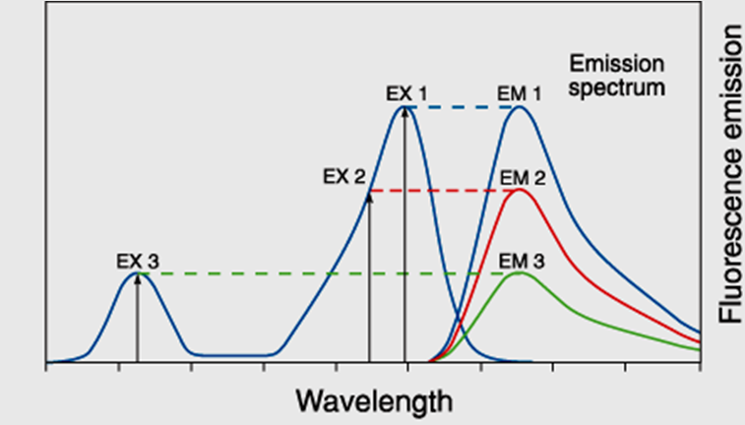
Excitation Spectrum
S₃
ν₃
ν₂
ν₁
Absorbance
ν₃
S₂
ν₂
ν₁
IC
S₁
ν₃
ν₂
ν₁
Fluorescence emission spectrum is the same regardless of the excitation wavelength!
Absorption
Fluorescence
But intensity changes!
S₀

Slide 32
Excitation Spectrum
Monitor emission (Fixed λ)
Absorbance
Scan Through Excitation λ

Slide 33
Measuring Excitation Spectra
Procedure
1) Shift emission grating to desired wavelength (monitor emission max)
2) Shift excitation grating to stating wavelength
3) Light source on
4) Light Hits the Sample
5) Emission from the sample enters emission monochromator
6) Detect emitted light at PMT
7) Raster excitation grating
Xenon Lamp
3
Excitation
Monochromator
Ex Grating
2
7
Emission
Monochromator
PMT
6
4
5
1
Sample
Em Grating

Slide 34
Excitation Spectrum
Excitation Spectrum
Absorption Spectrum
If emitting from a single species:
Excitation spectrum should match absorption spectrum!

Slide 35
Fluorometer
3
1
2
Components
1) Light source
2) Monochrometer
3) Sample
4) Detector
5) Filters
6) Slits
7) Polarizers
2
4

Slide 36
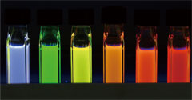

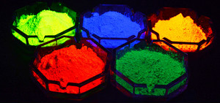
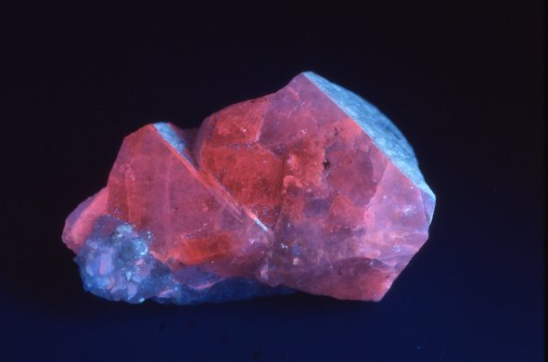
Samples
Solutions
Thin Films
Powders
Crystals

Slide 37
Solution Fluorescence
Top View
Source
Excitation
Beam
Emission
Excitation
hν
Detector
Sample
hν
Emission
non-emitting molecules
filter effect
“self”-absorption

Slide 38
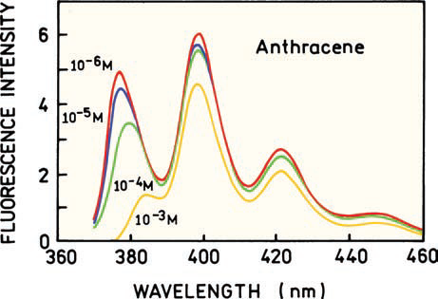
Filter Effect
Anthracene
For Fluorescent Samples:
Absorbance < 1.0

Slide 39
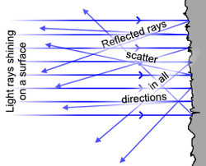
Solid Samples
Thin Films/Solids
Emission Spectrum
Ex: 380 nm
Source
Detector
Real emission spectrum +
Second Order
Sample

Slide 40
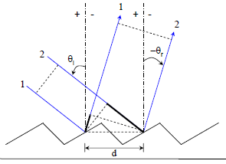
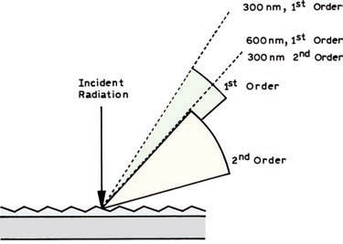
Solid Samples
Thin Films/Solids
Emission Spectrum
Ex: 380 nm
2d
λ = 2d(sin θ_{i} + sin θ_{r})
Detector at 760 nm sees 380 nm light!
Source
Detector
Real emission spectrum +
Second Order
Sample

Slide 41
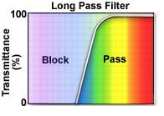
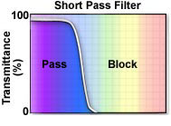

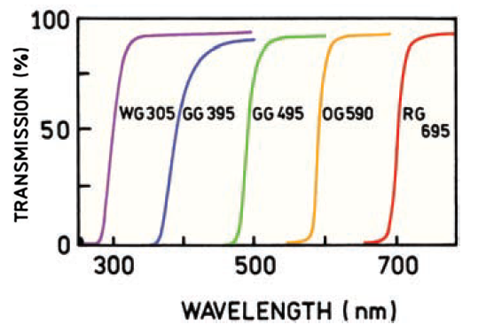
Filters

Slide 42
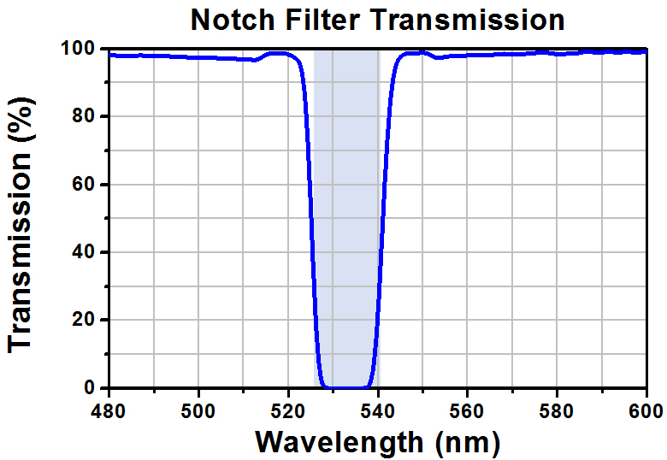
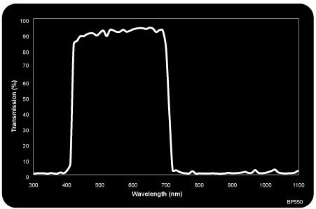
Filters
Band Pass Filter

Slide 43
Fluorometer
3
1
2
Components
1) Light source
2) Monochrometer
3) Sample
4) Detector
5) Filters
6) Slits
7) Polarizers
2
4

Slide 44
Fluorometer: Slits
Entrance Slit
Mirrors
Exit Slit

Slide 45
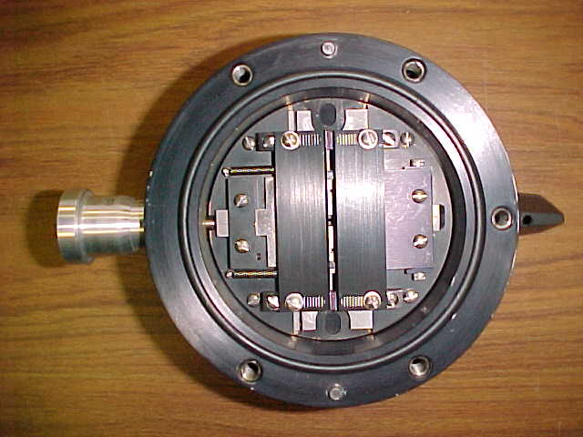
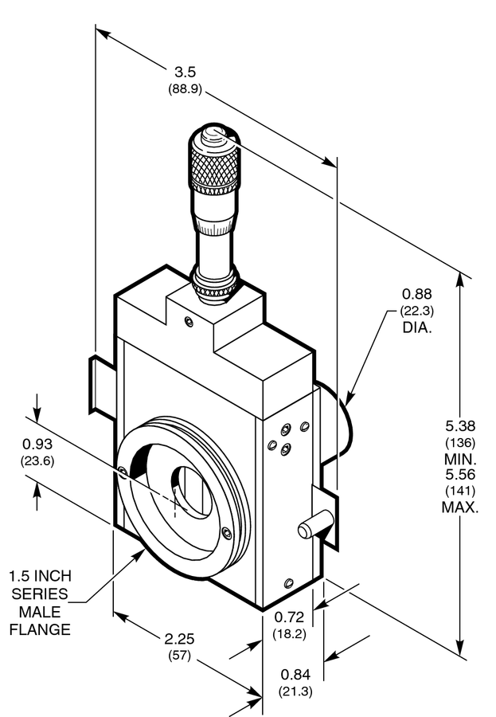

Fluorometer: Slits

Slide 46


Slit widths
Entrance Slit
Wider Slits:
More light hitting sample
More emission
More light hitting the detector
More signal
Greater signal-to-noise
But…resolution decreases!
Exit Slit
Entrance Slit
Source
hν
Sample

Slide 47

Slit widths
Entrance Slit
Source
hν
Sample
Small Slit
Large Slit
bandpass (nm) =
slit width (mm) x dispersion (nm mm⁻¹)
for a 4.25 nm mm⁻¹ grating

Slide 48
Excitation Slit widths
Single Component:
Wider slit:
Larger bandwidth
Intensity increase
No emission spectra change
Absorbance

Slide 49
Excitation Slit widths
Multi Component :
Wider slit:
Larger bandwidth
Intensity increase
Emission ratio changes (1:2)
-small slit less of dye 2
-large slits more of dye 2

Slide 50



Emission Slit widths
Wider slit:
Larger bandwidth
More light hitting the detector
More signal
Lower Resolution
Exit Slit
hν
Sample
Grating
Detector
doubled slits = intensity²
570 nm emission
Small Slit (0.5 mm)
Large Slit (2.0 mm)
summing 569-571 nm
(2.125 nm bandwidth)
summing 566-574 nm
(8.5 nm bandwidth)
Nyquist Rule: scanning increment should be greater than 1/2 slit widths
Ex: For 8 nm bandwidth set emission acquisition to 4 nm per step.

Slide 51


Emission Slit widths
Emission Intensity
Emission Intensity
Always report your slit widths (in nm)!

Slide 52
Fluorometer
3
1
2
Components
1) Light source
2) Monochrometer
3) Sample
4) Detector
5) Filters
6) Slits
7) Polarizers
2
4

Slide 53
Fluorometer: Polarizer
Mirrors
Polarizer
Polarizer

Slide 54

Fluorescence Anisotropy
Absorption is polarized
Fluorescence is also polarized

Slide 55


Slide 56


Absorption Probablity

Slide 57



Fluorescence Anisotropy
Detector
End View
Unpolarized
Light

Slide 58
Fluorescence Anisotropy
Detector
End View
Unpolarized
Light

Slide 59
Fluorescence Anisotropy
Detector
End View
End View
Unpolarized
Light
Unpolarized
Light

Slide 60
Fluorescence Anisotropy
Polarizer
Detector
End View
Polarized
Light

Slide 61
Fluorescence Anisotropy
Polarizer
Detector
End View
Polarized
Light

Slide 62
Fluorescence Anisotropy
Polarizer
Detector
End View
End View
I⊥
I||
Polarized
Light
Slightly
Polarized
Light

Slide 63



Fluorescence Anisotropy
Sample
I||
Detector
I⊥
Polarized Excitation
r = anisotropy factor
I|| and I⊥ are the intensities of the observed parallel and perpendicular components

Slide 64


Fluorescence Anisotropy
r = anisotropy factor
I|| and I⊥ are the intensities of the observed parallel and perpendicular components

Slide 65

Monitor Binding

Slide 66

Reaction Kinetics

Slide 67
Fluorometer
3
1
2
Components
1) Light source
2) Monochrometer
3) Sample
4) Detector
5) Filters
6) Slits
7) Polarizers
2
4

Slide 68








Other Sampling Accessories
Cryostat
Microplate Reader
Integrating Sphere
Spatial Imaging

Slide 69



Fluorescence Microscopy
Detector
“monochrometer”
Filter
Source
“monochrometer”
Filter
Sample
Translation stage

Slide 70


Fluorescence Microscopy
Nikon Eclipse Ti Inverted Microscope
LiveCell sample holder (model CC378A)
HQ²CCD camera
-1392x1040, 6.45 µm² pixels
-330-800 nm
Intensilight C-HGFI light source
MAC Lab
(Materials Characterization)
CSL 1008A
250 nm
600 nm

Slide 71

Confocal Fluorescence Microscopy

Slide 72


Ex vivo fluorescence images
ACS Omega, 2018, 3, 7888
Detector
“monochrometer”
Filter
Perkin Elmer, IVIS Spectrum
“monochrometer”
Filter
Sample
Source

Slide 73

Potential Complications
With Sample
Solvent Impurities
  -run a blank
Raman Bands
Concentration to high
- A > 1
- Self-absorption
Scatter (2nd order or spikes)
With the Instrument
Stray light
Slit Widths
Signal/Noise

Slide 74
Fluorescence Spectroscopy End
Any Questions?

